Slide 1
Power and Design for Cluster Random Assignment Experiments
Lecture 3: Extending the Formula
  Randall Juras
  March 2014

Slide 2
Plan for the Course
Lecture 1: Basic Ideas and Review
Lecture 2: The Cluster Power Formula
Lecture 3: Extending the Formula
Lecture 4: Applications and Other Issues

Slide 3
Plan for Lecture 3
Verify our spreadsheet results using Optimal Design and Power Up
Modify the spreadsheet to account for covariates
Modify the spreadsheet to account for unbalanced designs
What to do with binary outcomes

Slide 4
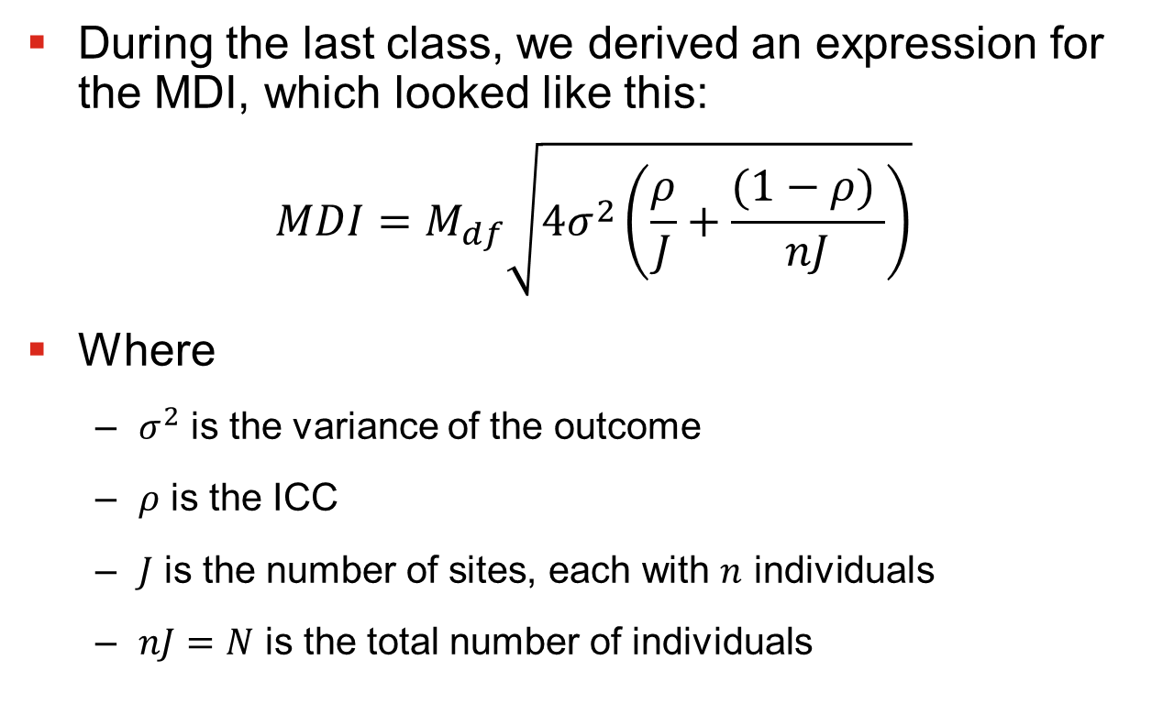
Review: Basic MDI/MDES
During the last class, we derived an expression for the MDI, which looked like this:
$$MDI=M_{df}\sqrt{4σ_{}^{2}\left(\frac{ρ}{J}+\frac{(1−ρ) }{nJ}\right)}$$
Where
  $σ_{}^{2}$ is the variance of the outcome
  $ρ$ is the ICC
  $J$ is the number of sites, each with $n$ individuals
  $nJ=N$ is the total number of individuals

Slide 5
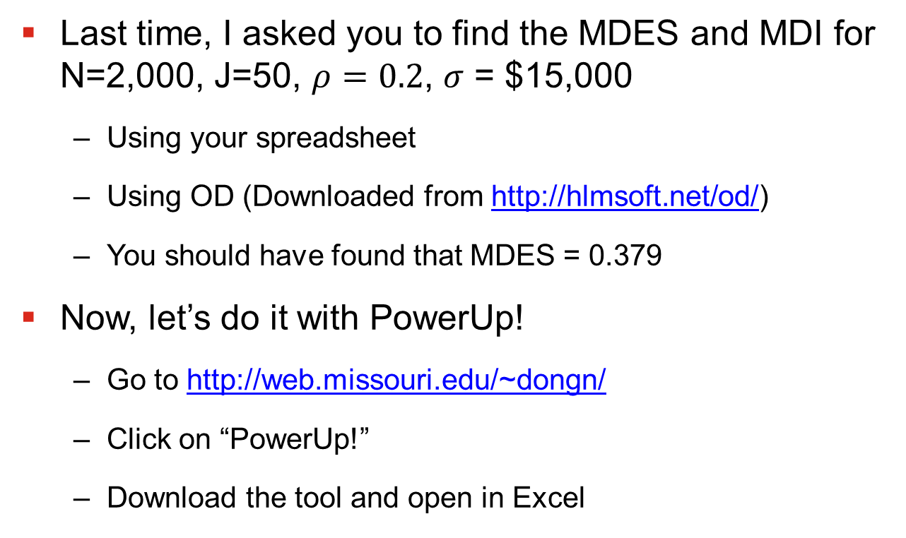
Sample Problem
Last time, I asked you to find the MDES and MDI for N=2,000, J=50, $ρ=0.2$, $σ$ = $15,000
  Using your spreadsheet
  Using OD (Downloaded from http://hlmsoft.net/od/)
  You should have found that MDES = 0.379
Now, let’s do it with PowerUp!
  Go to http://web.missouri.edu/~dongn/
  Click on “PowerUp!”
  Download the tool and open in Excel

Slide 6
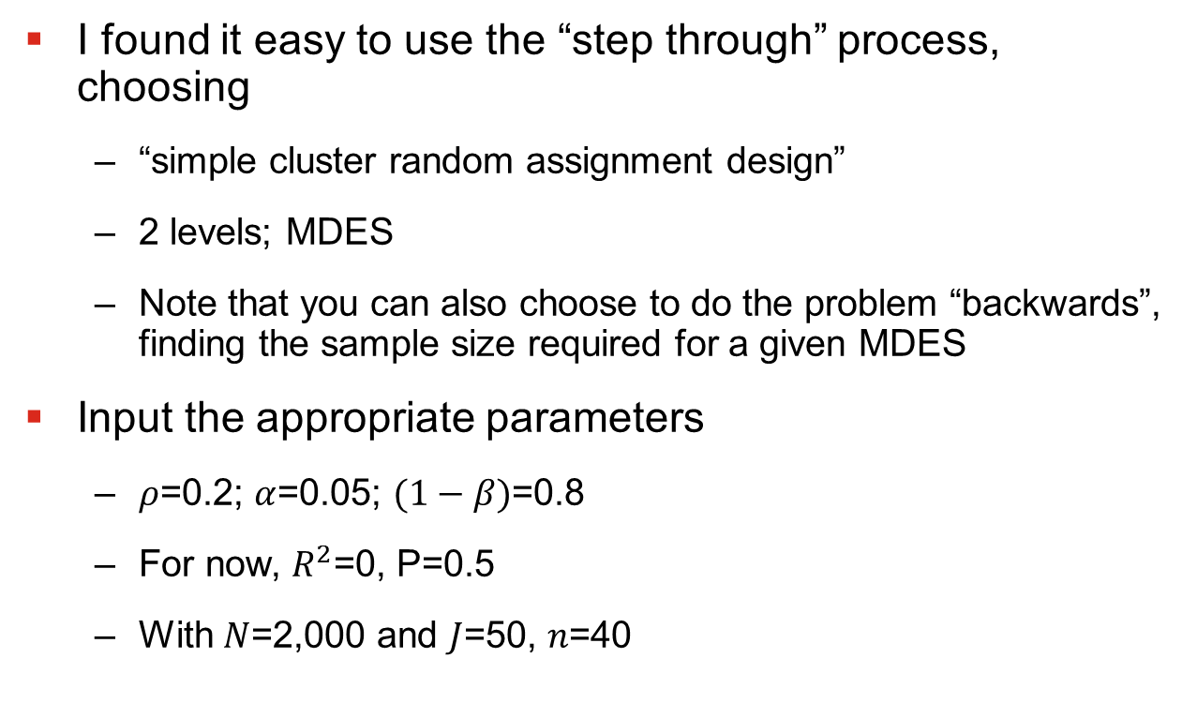
Power Up!
I found it easy to use the “step through” process, choosing
  “simple cluster random assignment design”
  2 levels; MDES
  Note that you can also choose to do the problem “backwards”, finding the sample size required for a given MDES
Input the appropriate parameters
  $ρ$=0.2; $α$=0.05; $(1−β)$=0.8
  For now, $R^{2}$=0, P=0.5
  With $N$=2,000 and $J$=50, $n$=40

Slide 7
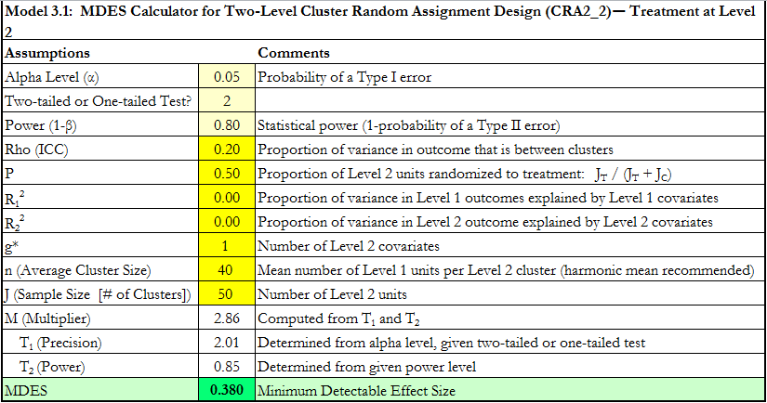
Power Up!

Slide 8
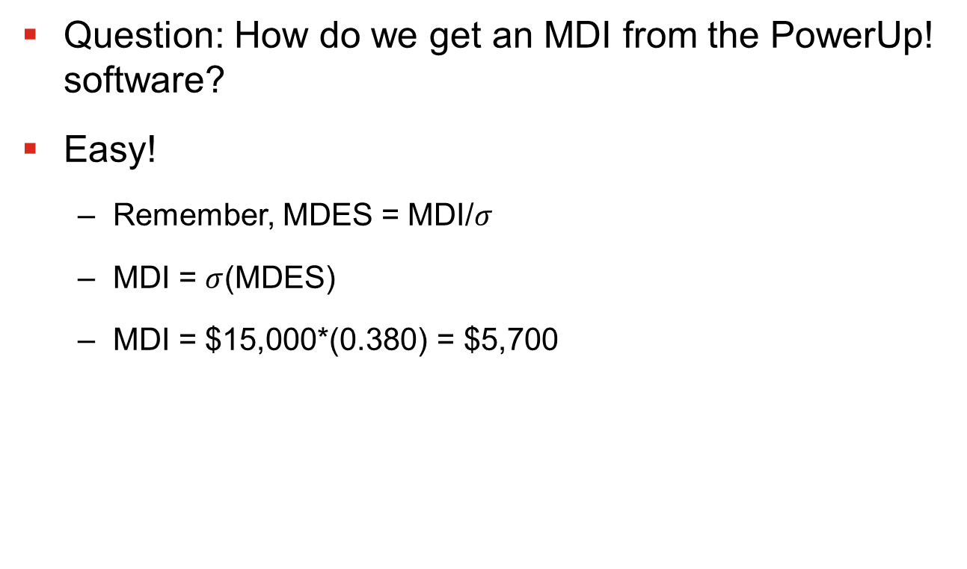
Power Up!
Question: How do we get an MDI from the PowerUp! software?
Easy!
  Remember, MDES = MDI/$σ$
  MDI = $σ$(MDES)
  MDI = $15,000*(0.380) = $5,700

Slide 9
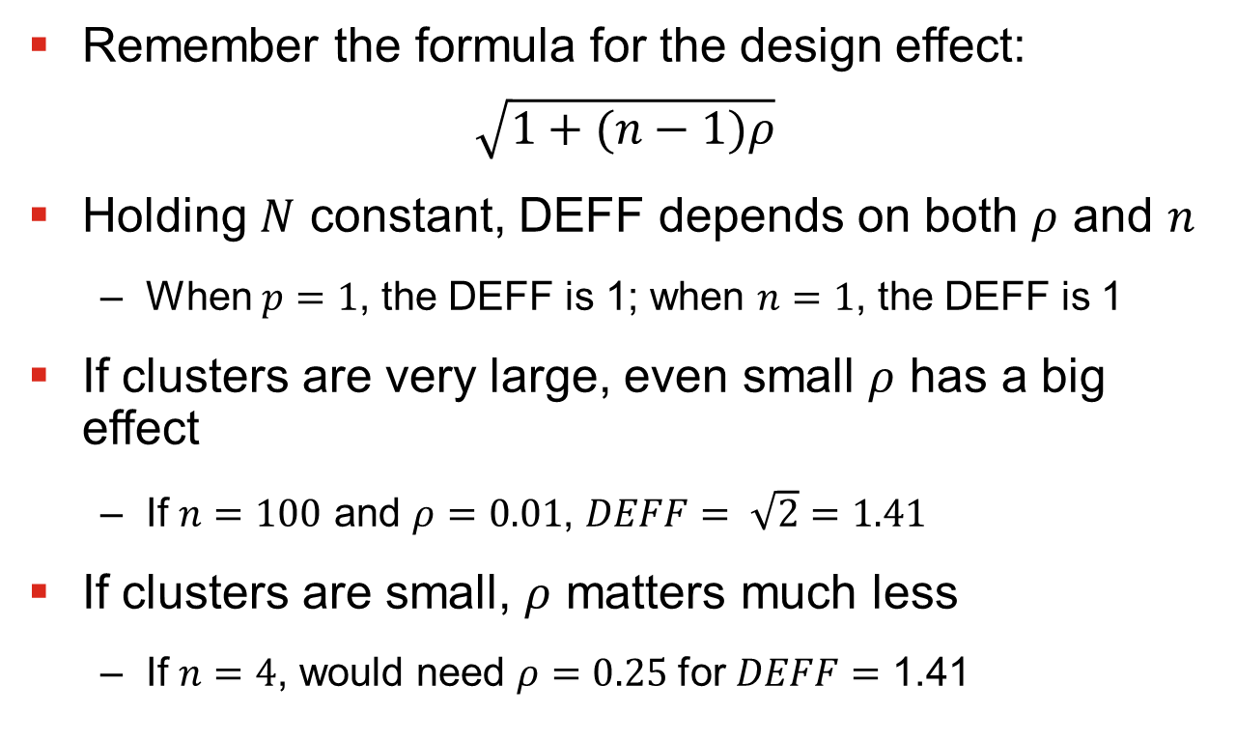
How Much Does Clustering Matter?
Remember the formula for the design effect:
$$\sqrt{1+(n−1)ρ}$$
Holding $N$ constant, DEFF depends on both $ρ$ and $n$
  When $p=1$, the DEFF is 1; when $n=1$, the DEFF is 1
If clusters are very large, even small $ρ$ has a big effect
  If $n=100$ and $ρ=0.01$, $DEFF= \sqrt{2}=1.41$
If clusters are small, $ρ$ matters much less
  If $n=4$, would need $ρ=0.25$ for $DEFF=$ 1.41

Slide 10
Covariates
So far the story is pretty gloomy
  Substantial power loss from cluster random assignment
  Need big sample sizes to detect reasonable impacts
Just like for individual random assignment, covariates can help
  Covariates can explain variation at both Level 1 and Level 2 of the model.
  Reducing Level 2 variance can help a lot with power
  Important: You don’t even need covariates to be measured at cluster level for this to happen

Slide 11
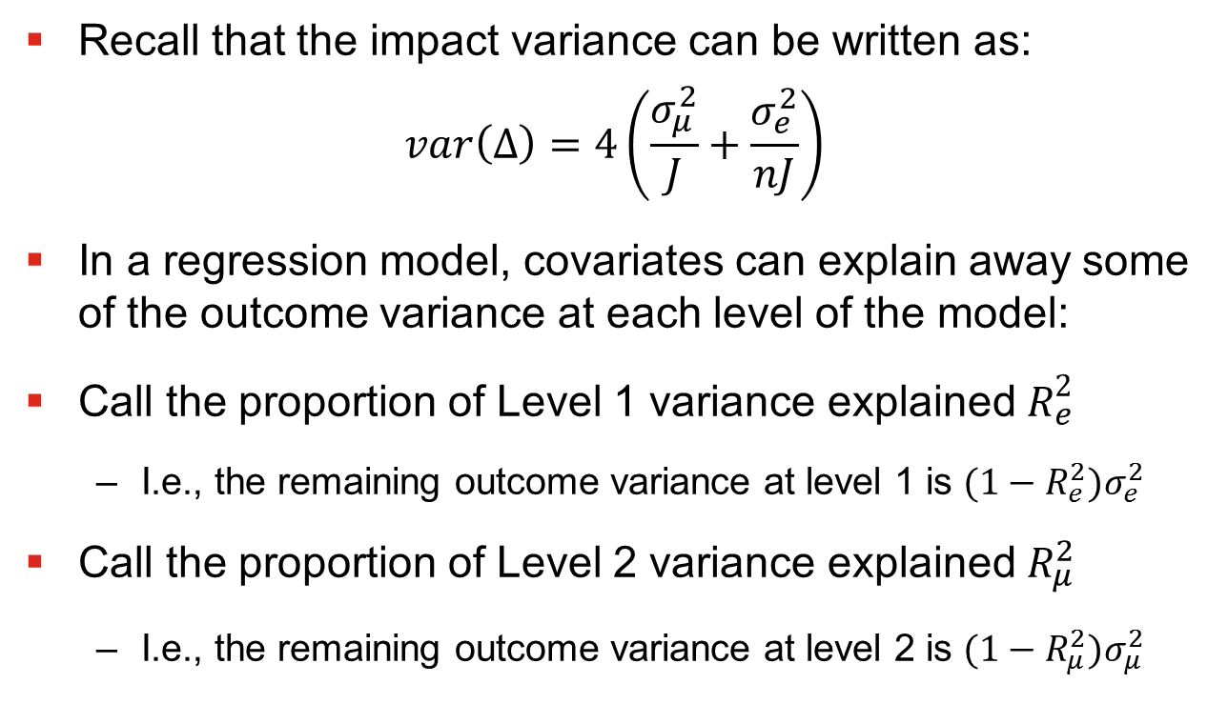
Covariates
Recall that the impact variance can be written as:
$$var\left(∆\right)=4\left(\frac{σ_{μ}^{2}}{J}+\frac{σ_{e}^{2}}{nJ}\right)$$
In a regression model, covariates can explain away some of the outcome variance at each level of the model:
Call the proportion of Level 1 variance explained $R_{e}^{2}$
  I.e., the remaining outcome variance at level 1 is ${(1−R_{e}^{2})σ}_{e}^{2}$
Call the proportion of Level 2 variance explained $R_{μ}^{2}$
  I.e., the remaining outcome variance at level 2 is ${(1−R_{μ}^{2})σ}_{μ}^{2}$

Slide 12
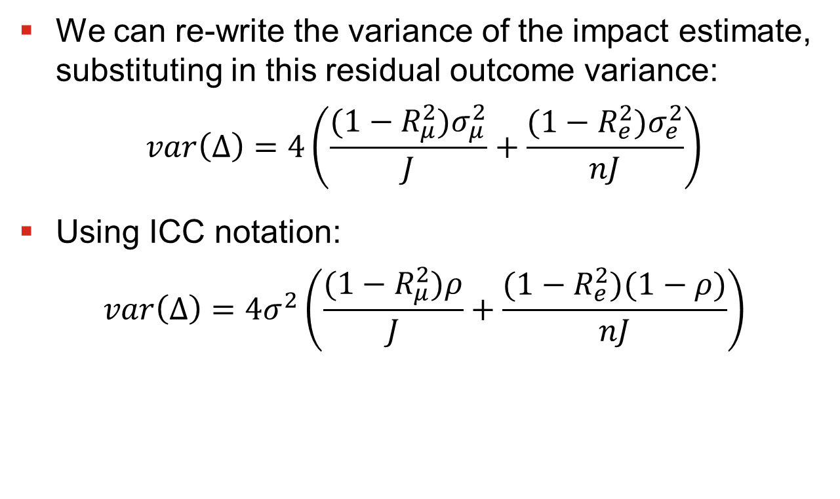
Covariates
We can re-write the variance of the impact estimate, substituting in this residual outcome variance:
$$var\left(∆\right)=4\left(\frac{{(1−R_{μ}^{2})σ}_{μ}^{2}}{J}+\frac{{(1−R_{e}^{2})σ}_{e}^{2}}{nJ}\right)$$
Using ICC notation:
$$var\left(∆\right)=4σ^{2}\left(\frac{(1−R_{μ}^{2})ρ}{J}+\frac{(1−R_{e}^{2})(1−ρ)}{nJ}\right)$$

Slide 13
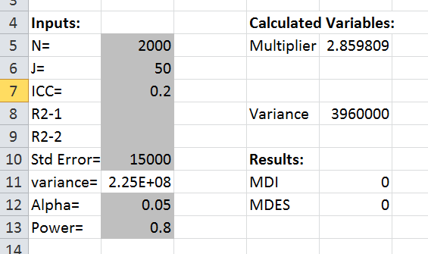
Adding Covariates to Spreadsheet
Adding this functionality to the spreadsheet is easy
First, create fields to input the R-squares
  I inserted two new rows to do this

Slide 14
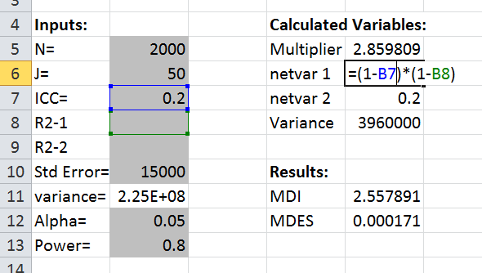

Adding Covariates to Spreadsheet
Now, calculate the residual outcome variance at levels 1 and 2 as $(1−R_{e}^{2})(1−ρ)$ and $(1−R_{μ}^{2})ρ$

Slide 15
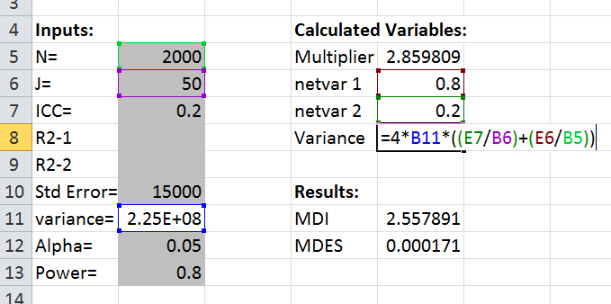
Adding Covariates to Spreadsheet
Finally, substitute these terms for the residual outcome variance into the formula for the variance of the impact estimate:

Slide 16
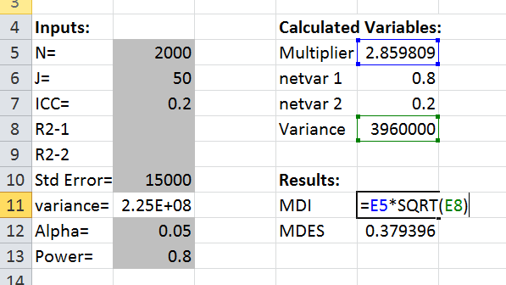
Adding Covariates to Spreadsheet
Finally, make sure to change the cell references in the MDI formula:

Slide 17
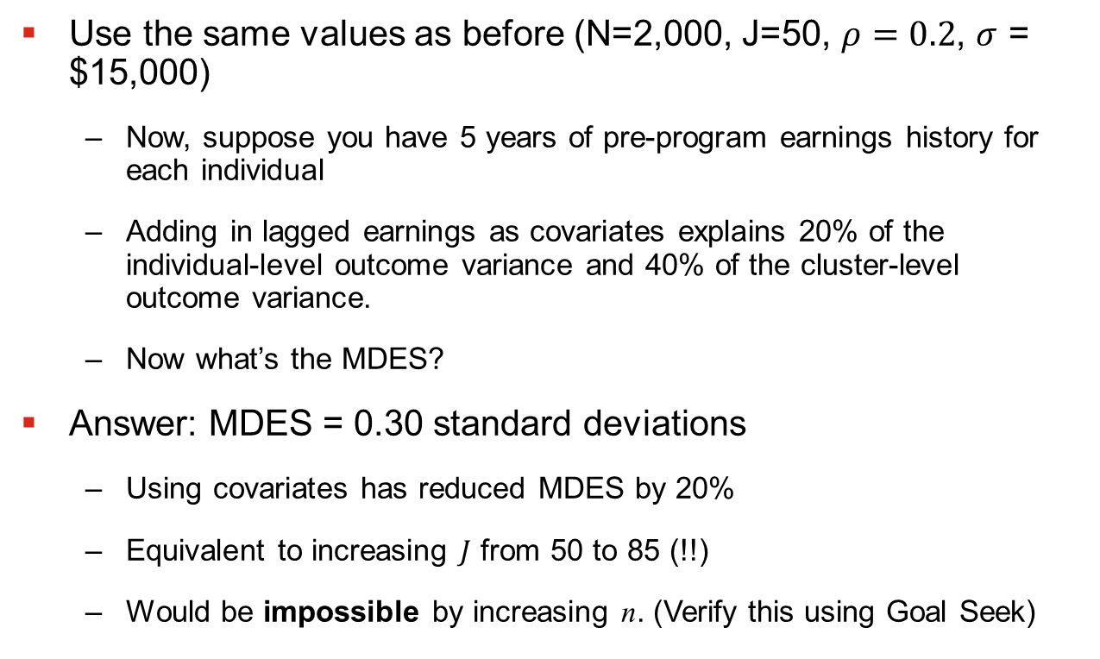
Sample Problem with Covariates
Use the same values as before (N=2,000, J=50, $ρ=0.2$, $σ$ = $15,000)
  Now, suppose you have 5 years of pre-program earnings history for each individual
  Adding in lagged earnings as covariates explains 20% of the individual-level outcome variance and 40% of the cluster-level outcome variance.
  Now what’s the MDES?
Answer: MDES = 0.30 standard deviations
  Using covariates has reduced MDES by 20%
  Equivalent to increasing $J$ from 50 to 85 (!!)
  Would be impossible by increasing n. (Verify this using Goal Seek)

Slide 18
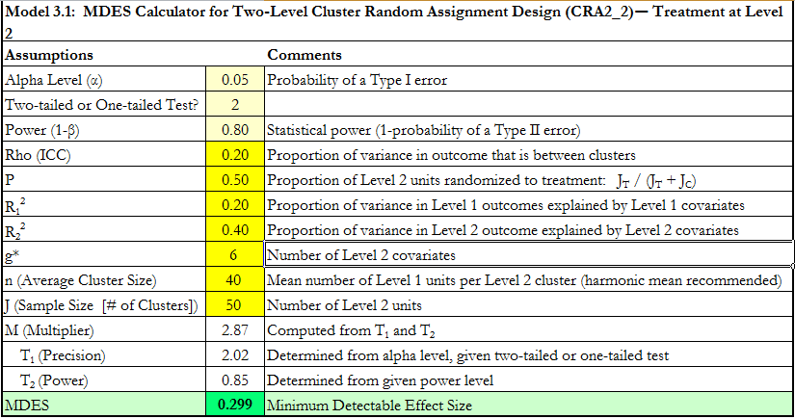

Covariates in Power Up
In PowerUp!, you simply enter the $R_{1}^{2}$ and $R_{2}^{2}$

Slide 19
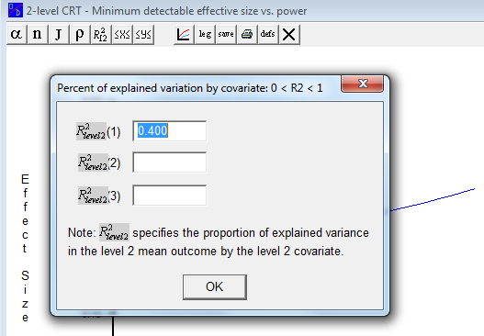

Covariates in Optimal Design
Optimal design does not care about $R_{e}^{2}$. It only wants $R_{μ}^{2}$. (The idea is that $R_{e}^{2}$ is relatively unimportant).

Slide 20
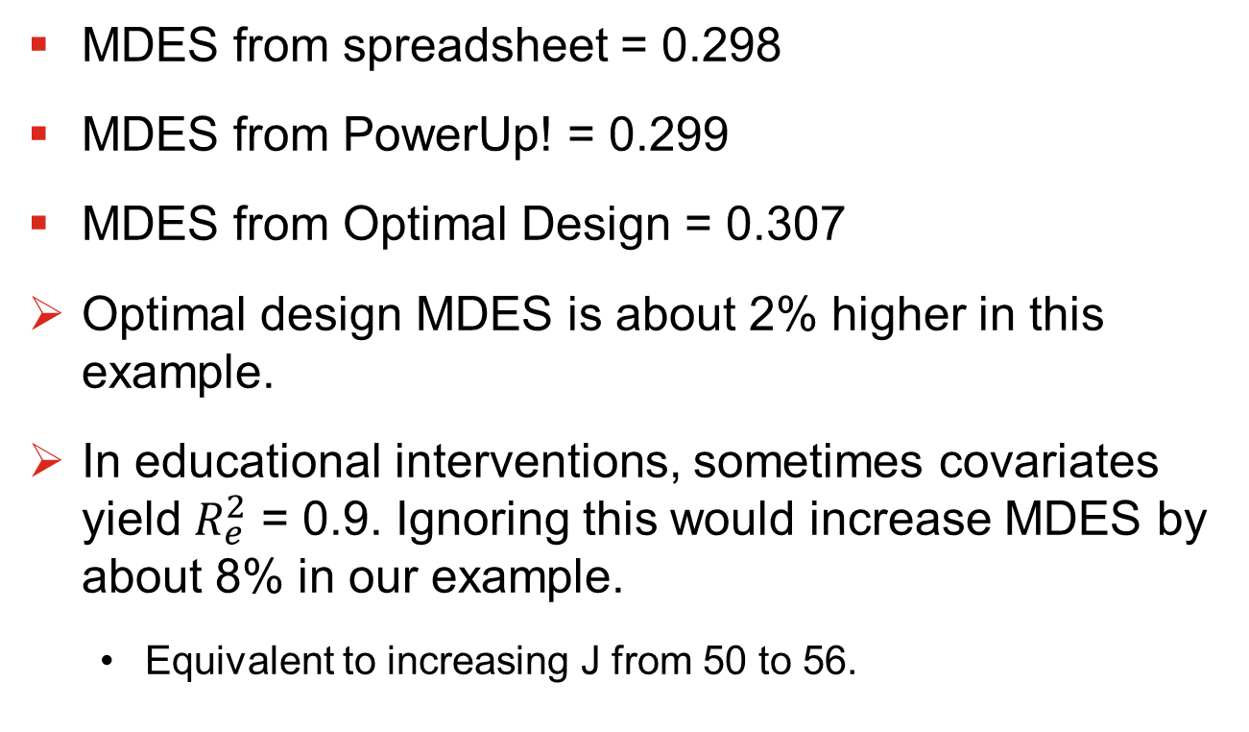

Is the Individual $R^{2}$ Important?
MDES from spreadsheet = 0.298
MDES from PowerUp! = 0.299
MDES from Optimal Design = 0.307
Optimal design MDES is about 2% higher in this example.
In educational interventions, sometimes covariates yield $R_{e}^{2}$ = 0.9. Ignoring this would increase MDES by about 8% in our example.
  Equivalent to increasing J from 50 to 56.

Slide 21
Unbalanced Random Assignment
Sometimes you do not want to randomly assign clusters in a 1:1 Treatment-to-Control ratio.
  Limited funding for program implementation
    Would imply more assigned to control
  Desire not to exclude too many from the treatment
    Would imply more assigned to treatment
We can modify the formula for MDI/MDES to account for this.
  But I am not going to walk through all the derivations; just provide some intuition

Slide 22
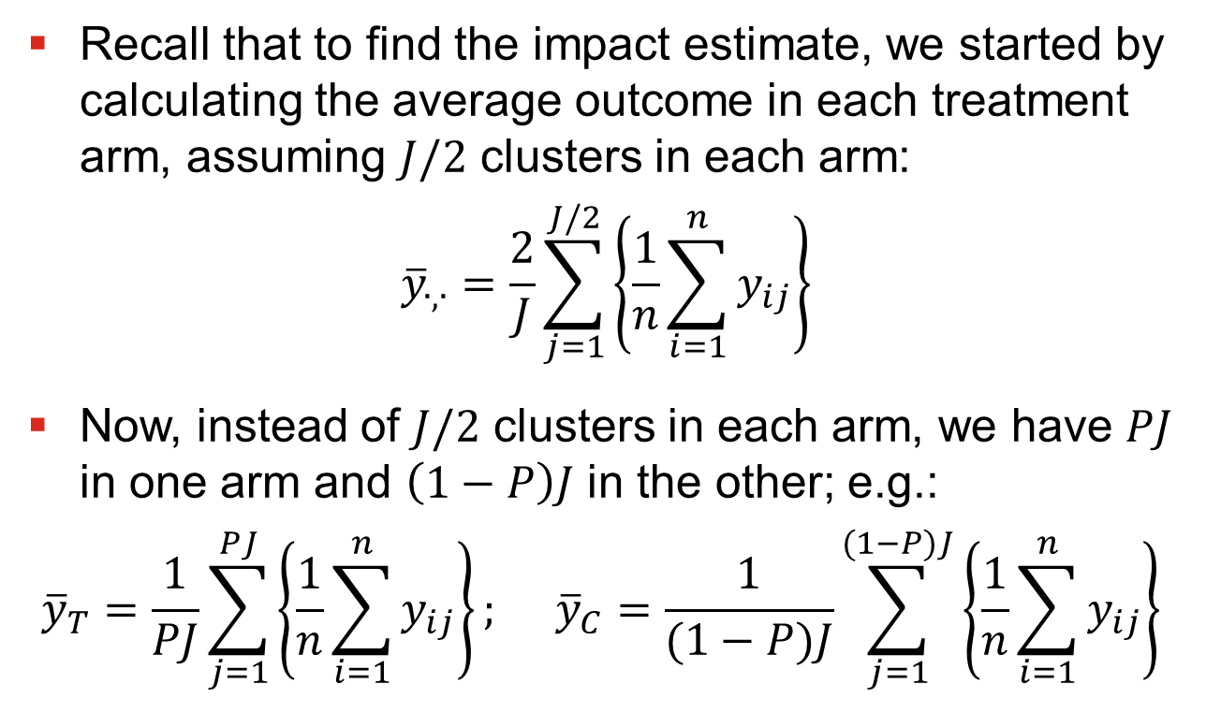
Unbalanced Random Assignment
Recall that to find the impact estimate, we started by calculating the average outcome in each treatment arm, assuming $J/2$ clusters in each arm:
$${\overline{y}}_{∙,∙}=\frac{2}{J}\sum_{j=1}^{J/2}{\left\{\frac{1}{n}\sum_{i=1}^{n}{y_{ij}}\right\}}$$
Now, instead of $J/2$ clusters in each arm, we have $PJ$ in one arm and $\left(1−P\right)J$ in the other; e.g.:
$${\overline{y}}_{T}=\frac{1}{PJ}\sum_{j=1}^{PJ}{\left\{\frac{1}{n}\sum_{i=1}^{n}{y_{ij}}\right\}; }{\overline{y}}_{C}=\frac{1}{(1−P)J}\sum_{j=1}^{(1−P)J}{\left\{\frac{1}{n}\sum_{i=1}^{n}{y_{ij}}\right\}}$$

Slide 23
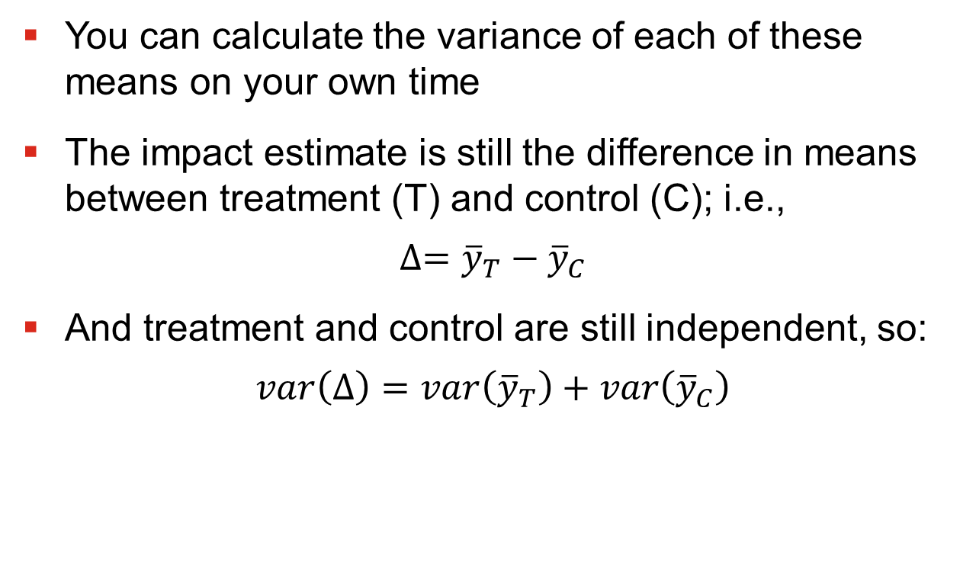
Unbalanced Random Assignment
You can calculate the variance of each of these means on your own time
The impact estimate is still the difference in means between treatment (T) and control (C); i.e.,
$$∆={\overline{y}}_{T}−{\overline{y}}_{C}$$
And treatment and control are still independent, so:
$$var\left(∆\right)=var\left({\overline{y}}_{T}\right)+var\left({\overline{y}}_{C}\right)$$

Slide 24
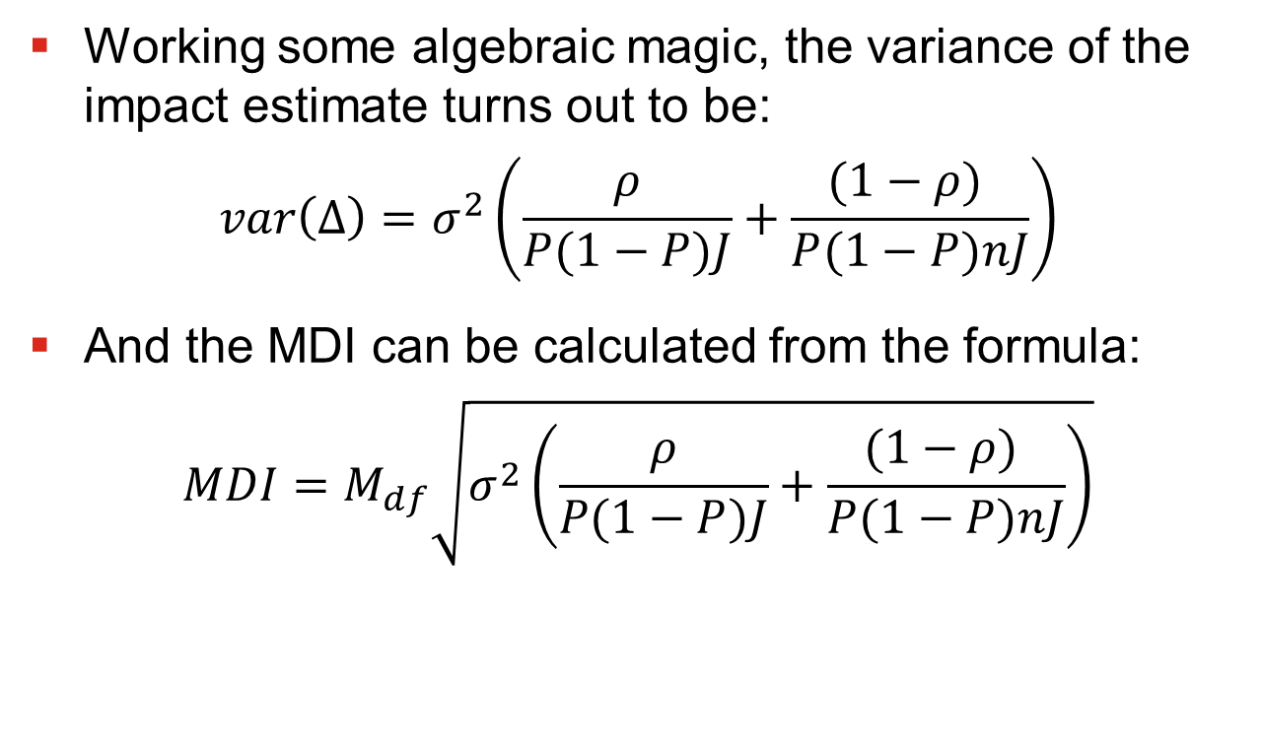
Unbalanced Random Assignment
Working some algebraic magic, the variance of the impact estimate turns out to be:
$$var\left(∆\right)=σ_{}^{2}\left(\frac{ρ}{P(1−P)J}+\frac{(1−ρ) }{P(1−P)nJ}\right)$$
And the MDI can be calculated from the formula:
$$MDI=M_{df}\sqrt{σ_{}^{2}\left(\frac{ρ}{P(1−P)J}+\frac{(1−ρ) }{P(1−P)nJ}\right)}$$

Slide 25
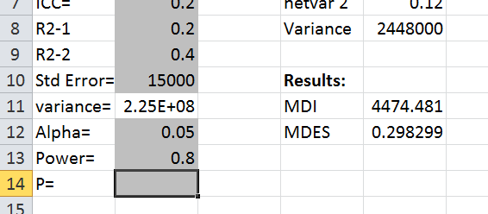

Imbalance in the Spreadsheet
We only need to make a couple changes to incorporate this in the spreadsheet
  First, Add a field for entering $P$
  It does not matter if $P$ represents the proportion assigned to treatment or the proportion assigned to control

Slide 26
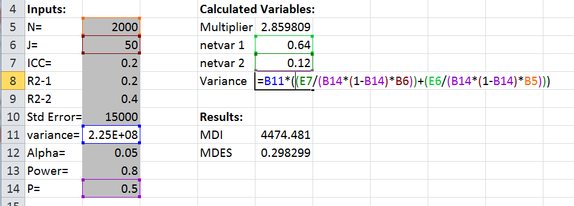

Imbalance in the Spreadsheet
Now, simply need to change the formula for the impact variance to incorporate $P(1−P)$
  Remember to take out the “4”, or you are double counting!

Slide 27
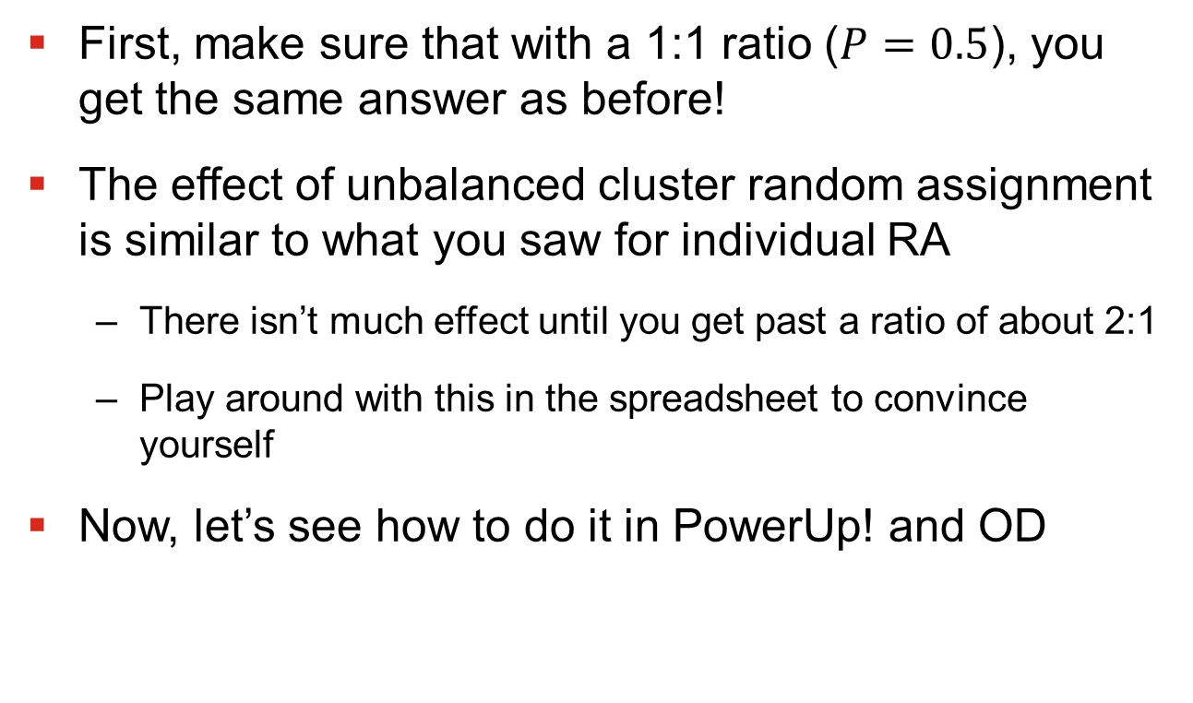
Unbalanced RA in Practice
First, make sure that with a 1:1 ratio ($P=0.5$), you get the same answer as before!
The effect of unbalanced cluster random assignment is similar to what you saw for individual RA
  There isn’t much effect until you get past a ratio of about 2:1
  Play around with this in the spreadsheet to convince yourself
Now, let’s see how to do it in PowerUp! and OD

Slide 28
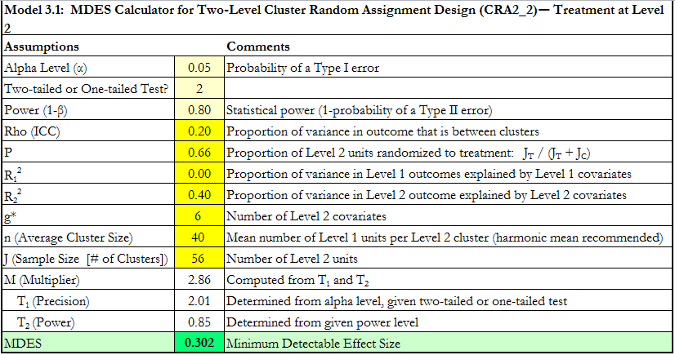

Unbalanced RA in PowerUp
Easy; just change the value for $P$

Slide 29
Unbalanced RA in OD
Surprisingly, Optimal Design does not appear to be capable of accounting for unbalanced designs
  As far as I know.
  This is probably because it would have to link to other functionality, like cost optimization tool

Slide 30
Binary Variables
Everything we have done so far assumes a continuous outcome, like earnings or test scores
What should we do with a binary outcome (e.g., employment)?
  This problem turns out to be quite difficult to solve!
  The easiest thing to do is to use a linear probability model; i.e. pretend the outcome is continuous.
  This will give you approximately the right answer in most cases

Slide 31
An Unanswered Question
Since these things are so easy to do in PowerUp! And Optimal Design, why have we spent all this time making a spreadsheet?
  It forces you to think about what’s going on behind the interface
  I would use the commercial software for most simple problems – It’s well-established and hard to screw up!
  That said, commercial software sometimes won’t do things that you can program yourself (e.g., OD will not account for unbalanced designs)

Slide 32
Next Lecture
Other topics!
  How to find the minimum cost evaluation design
  How to find ICCs using existing data
  What else do you most want to know?

